Slide 1

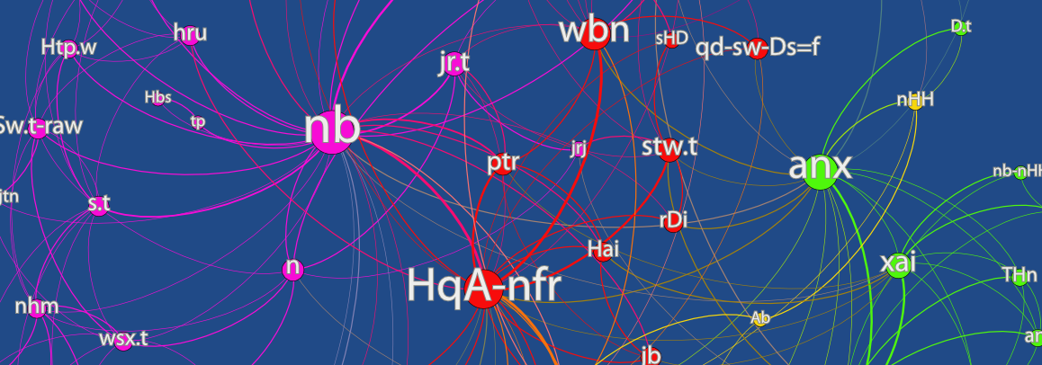
NETWORK VISUALIZATION
FREDERIK ELWERT
July 7, 2014

Slide 2
What
do we
visualize?
Notes:
<Nummer>

Slide 3
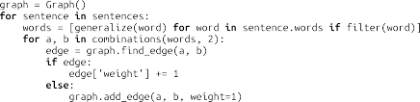
Cooccurrence Networks
Notes:
<Nummer>

Slide 4
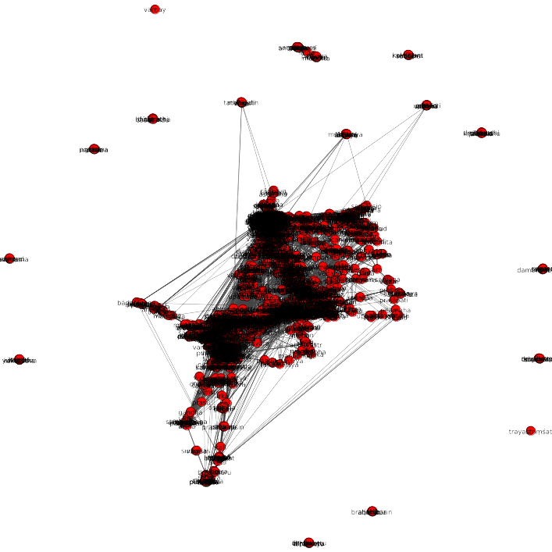

Slide 5
How
do we
visualize?
Notes:
<Nummer>

Slide 6
I.
Layout

Slide 7
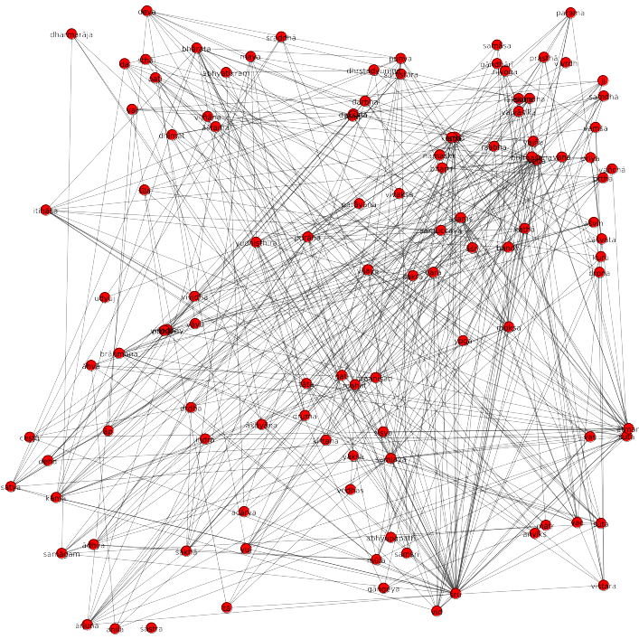

Slide 8
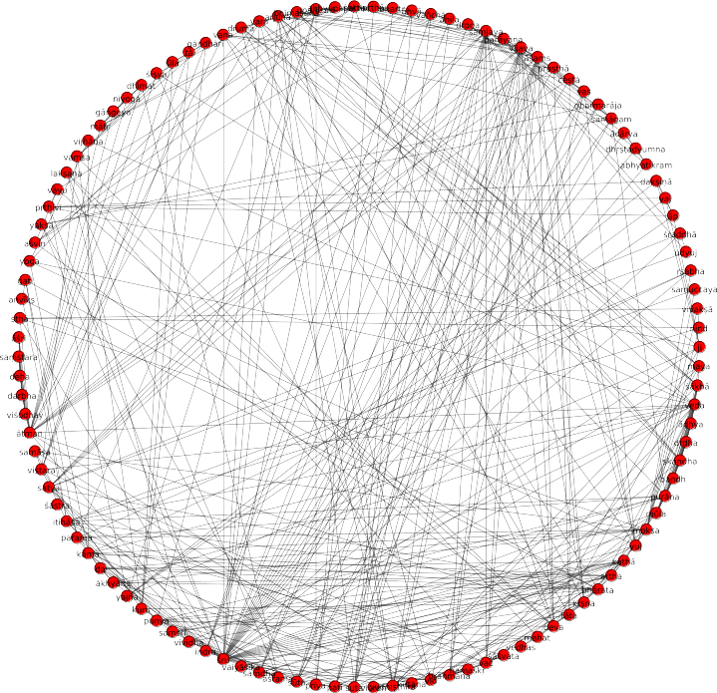

Slide 9
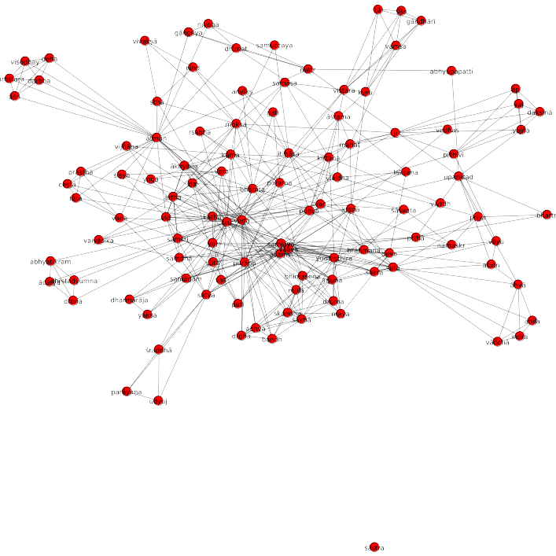

Slide 10
II. Properties

Slide 11
map(
data
to
style)

Slide 12
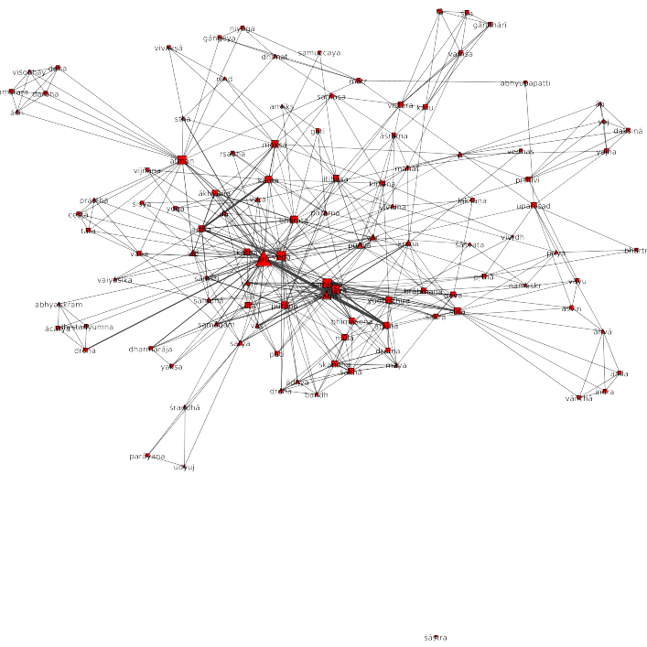

Slide 13
III. Structure

Slide 14
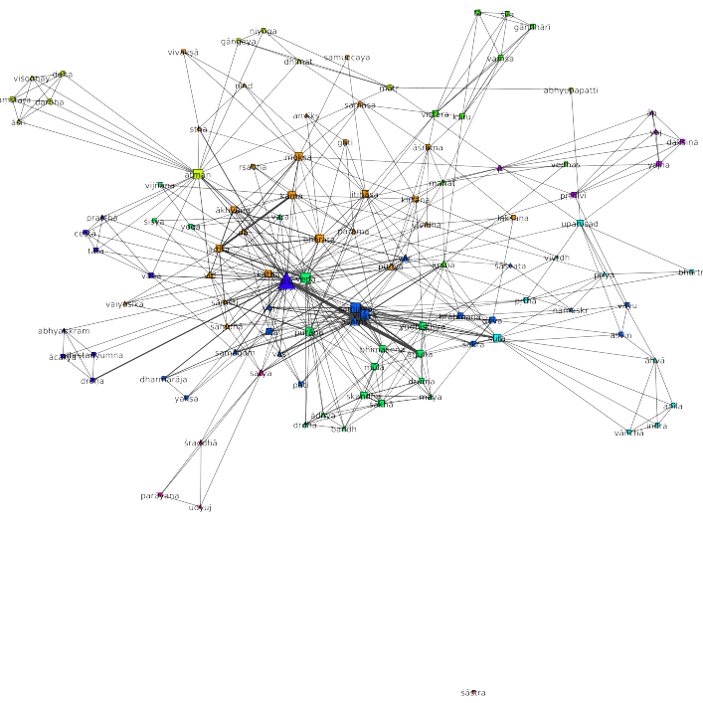

Slide 15
going LARGE
Notes:
<Nummer>

Slide 16
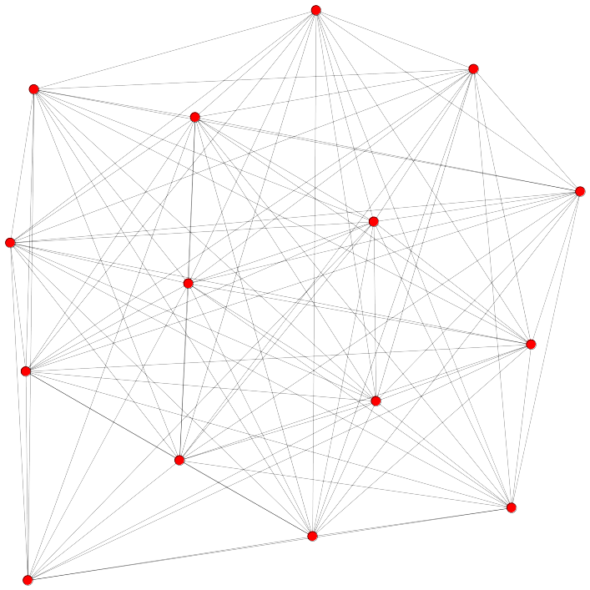

Slide 17
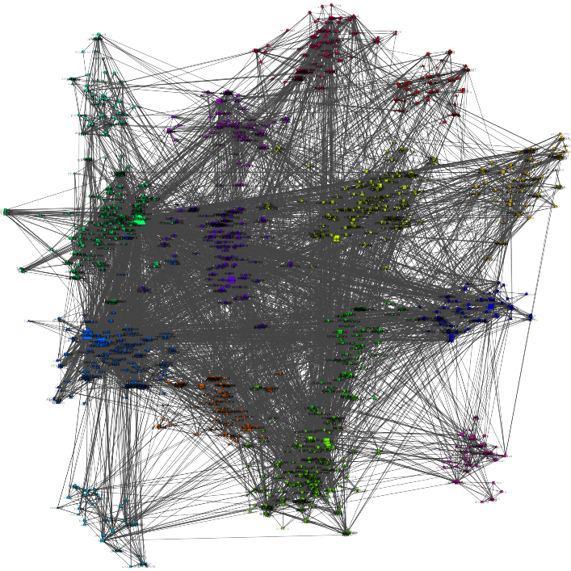

Slide 18


